Slide 1
Figures for DC analysis

Slide 2
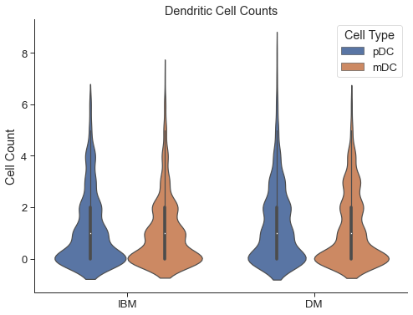
Violin plot as I’ve shown before

Slide 3
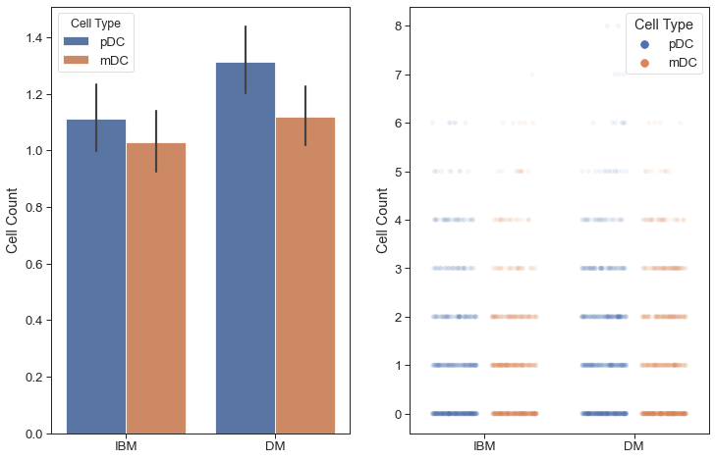
Bar plot on left shows mean with 95% confidence interval
Strip plot on right shows all observations. This has been difficult to show due to the sheer number of them and discrete nature of the observation values. I added transparency so the darker regions have more points, but could also do sampling or other options

Slide 4
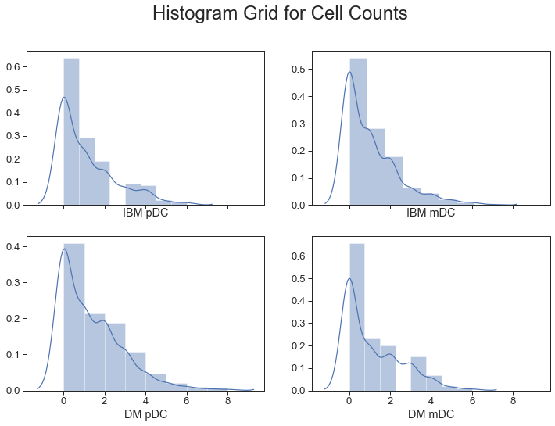
This is a new graph that I figured I would get your opinion on. Each histogram shows the distribution of observation values for the 4 combinations of disease (IBM,DM) and cell type (mDC, pDC).
The histograms are normalized with a kernel density estimation overlaid (but many of these options can be changed)

